Slide 1

World-wide Energy Consumption & Emission Analysis
Presented by:
Narla Yaswanth Simha Reddy
Satish Rayudu
Shashank Reddy Komatireddy

Slide 2
About Us
1 . Name : Narla Yaswanth Simha Reddy
Background : M.Sc (Cloud Computing)
Linked in: https://www.linkedin.com/in/yaswanth-narla/
GitHub : https://github.com/YaswanthNarla
2. Name : Satish Rayudu
Background : B.Tech (Computer Science & Engineering )
Linked in: https://www.linkedin.com/in/satish-rayudu-036141237/
GitHub : https://github.com/satish-rayudu
3. Name : Shashank Reddy Komatireddy
Background : B.Tech ( Computer Science & Engineering )
Linked in: https://www.linkedin.com/in/shashank-reddy-komatireddy-ksr2310/
GitHub : https://github.com/Shashankreddy2003

Slide 3
Introduction
This project focuses on analyzing global data related to energy production, energy consumption, emissions, GDP, and population using SQL.
The dataset is structured across multiple interconnected tables, allowing us to study how energy usage patterns influence economic growth and environmental impact. It helps track sales, revenue ensuring better decision-making and timely product availability.
By performing queries such as year-over-year analysis, energy balance (production vs consumption), emission trends, and per capita calculations, the project uncovers meaningful patterns across countries.
The goal is to transform raw data into actionable insights that highlight sustainability challenges, economic dependencies on energy, and global emission behavior.

Slide 4
Objective of the Project
Analyze the relationship between energy production, consumption, and emissions across countries.
Identify top-performing countries in GDP and study their energy usage patterns.
Evaluate energy balance (surplus or deficit) using production vs consumption data.
Examine year-over-year trends in emissions, GDP, and energy consumption.
Perform per capita analysis to compare countries fairly.
Calculate key metrics like emission-to-GDP ratio for deeper insights.

Slide 5


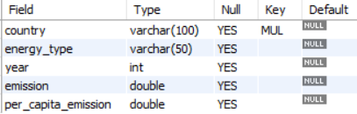
ABOUT TABLES
Country Table
Population Table
Emission_3 Table

Slide 6
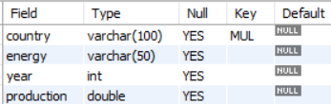

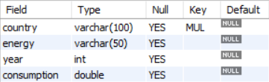
Production Table
gdp_3 Table
ConsumptionTable

Slide 7
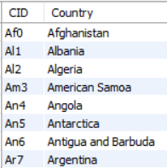
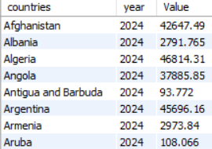
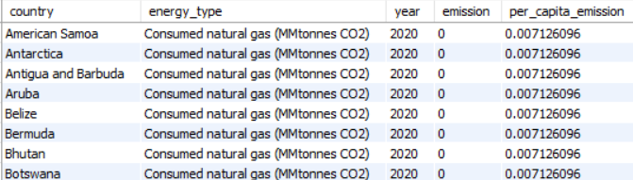
Sample inserted values:
Country Table
Population Table
Emission_3 Table

Slide 8
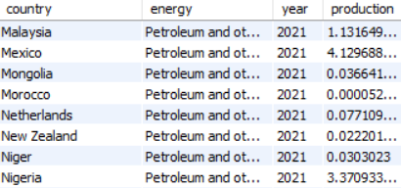
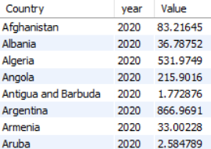
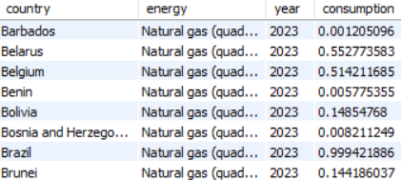
Production Table
gdp_3 Table
ConsumptionTable

Slide 9
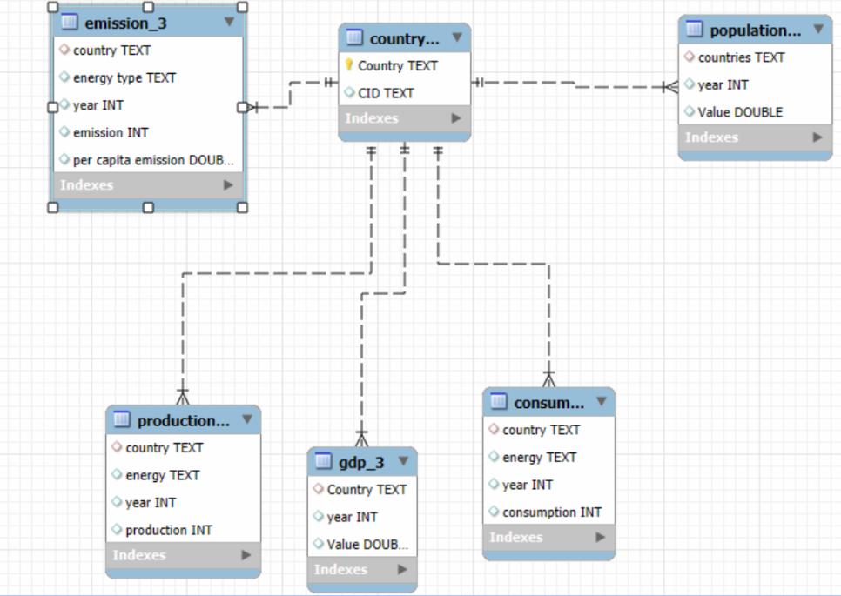
ER Diagram and schema explanation
Table relations:
● One-to-Many from country to emission_3
● One-to-Many from country to population
● One-to-Many from country to production
● One-to-Many from country to consumption
● One-to-Many from country to gdp_3

Slide 10
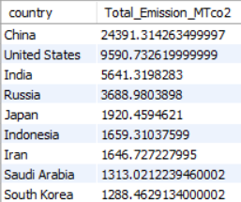
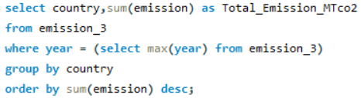
General & Comparative Analysis. 1. What is the total emission per country for the most recent year available?
Output
Query
Key Insights:
The total emissions differ widely across countries in the most recent year, with a few countries contributing significantly higher emissions while many others have relatively low levels.

Slide 11

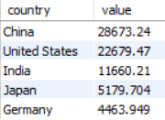
2. What are the top 5 countries by GDP in the most recent year?
Query
Output
Key Insights:
China and the United States lead global GDP rankings.
India is emerging as a strong top economy followed by Japan and germany.
Economic power is concentrated among a few countries.

Slide 12
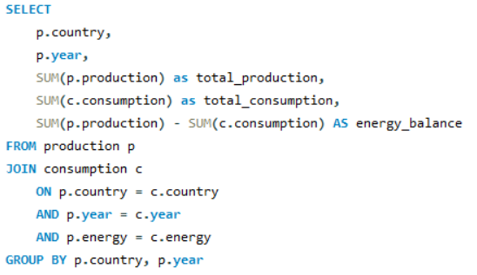
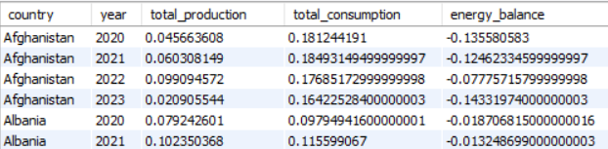
3. Compare energy production and consumption by country and year?
Query
Output
Key Insights:
Many countries show higher consumption than production, resulting in energy deficit.
Some countries have balanced or surplus energy, producing more than they consume.
Indicates dependency on energy imports for deficit countries.

Slide 13


4. Which energy types contribute most to emissions across all countries?
Query
Output
Key Insights:
Coal and coke contribute the highest emissions
Petroleum and other liquids are also major contributors
Natural gas contributes significantly but less than coal
Shows that fossil fuels dominate global emissions

Slide 14
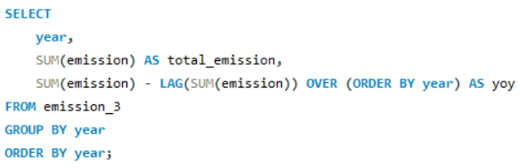
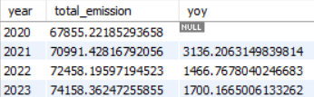
Trend Analysis Over Time 1. How have global emissions changed year over year?
Query
Output
Key Insights:
Global emissions show a consistent increasing trend over the years.
There is a positive year-over-year growth, indicating rising emissions.
Suggests increasing energy usage and environmental impact globally

Slide 15
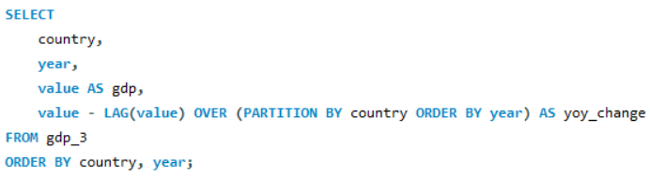
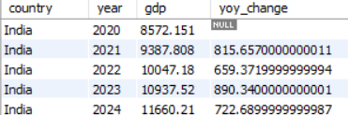
2. What is the trend in GDP for each country over the given years?
Query
Output
Key Insights:
Most countries show a steady increase in GDP from 2020–2024, indicating economic recovery and growth after 2020
Some countries (e.g., Afghanistan, Lebanon) show a declining or fluctuating trend due to instability.
A few countries experience temporary drops followed by recovery, showing economic shocks and rebounds.
Overall, the global trend is positive growth with minor fluctuations across year

Slide 16
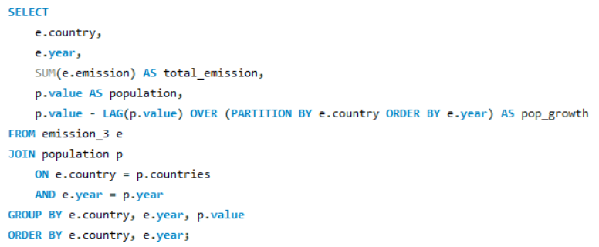
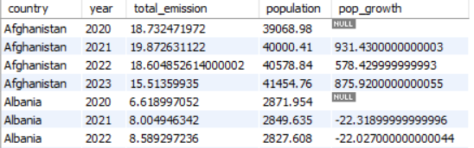
3. How has population growth affected total emissions in each country?
Query
Output
Key Insights:
In many countries, increase in population leads to higher emissions
Some countries show emission changes even with stable population, indicating other factors
Overall, population growth has a positive impact on total emissions

Slide 17
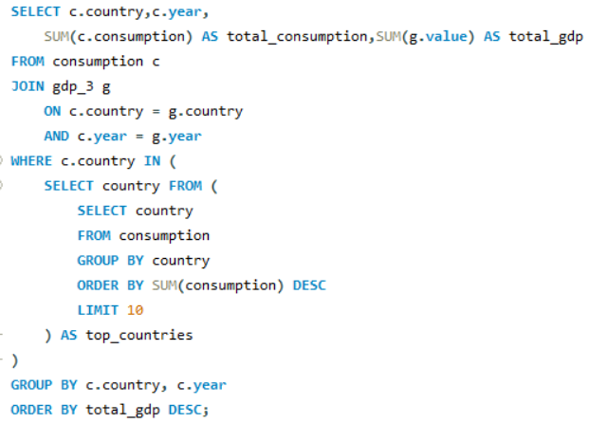
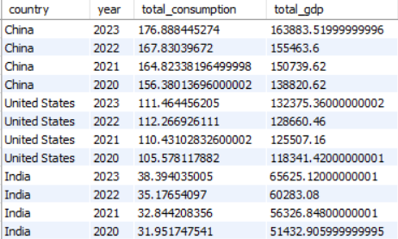
4. Has energy consumption increased or decreased over the years for major economies?
Output
Query
Key Insights:
Most major economies show increasing energy consumption over time.
China and India have the strongest growth.
Germany, Japan, and Russia show slight decline or fluctuation.

Slide 18
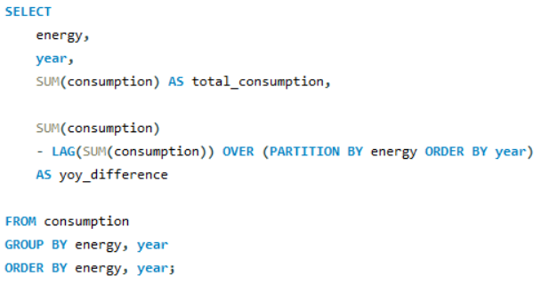
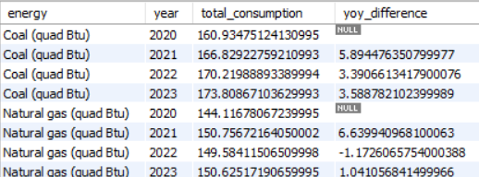
5.Which energy sources show the fastest growth in consumption over time across all countries?
Query
Output
Key Insights:
Petroleum and other liquids show the fastest and most consistent growth with the highest increases.
Natural gas grows quickly but is unstable with fluctuations over time.
Renewables grow steadily, indicating a gradual shift toward clean energy.

Slide 19
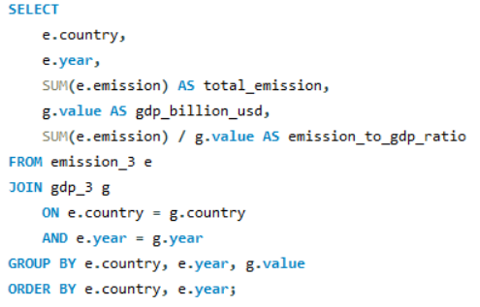
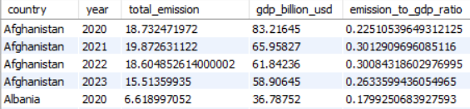
Ratio & Per Capita Analysis. 1. What is the emission-to-GDP ratio for each country by year? Query
Output
Key Insights:
Emission-to-GDP ratio varies widely across countries and years .
Higher ratios indicate more emission-intensive economies, while lower ratios show better sustainability
Some countries show improvement over time with decreasing ratios

Slide 20
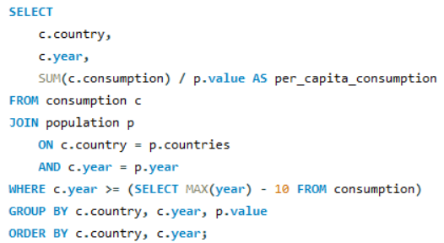
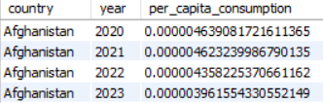
2. What is the energy consumption per capita for each country over the last decade?
Query
Output
Key Insights:
Countries like Qatar, UAE, and Bahrain show very high per capita energy consumption.
Developed and resource-rich countries generally have higher consumption per person
Developing countries show lower consumption, indicating limited access and usage

Slide 21
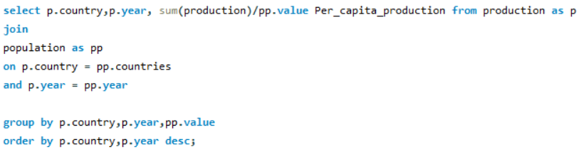
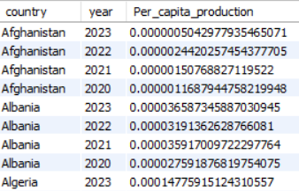
3. How does energy production per capita vary across countries? Query Output
Key Insights:
Countries like Qatar, Kuwait, and Norway have very high energy production per capita.
Developed/resource-rich countries produce more energy per person.
Many countries show very low values, indicating limited production or high population.

Slide 22
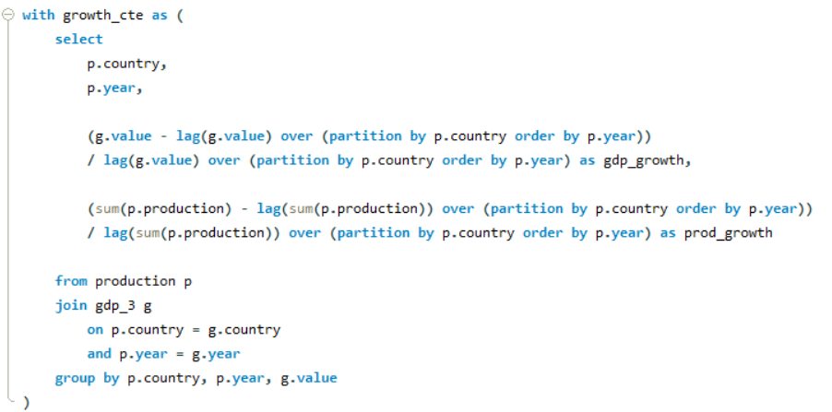
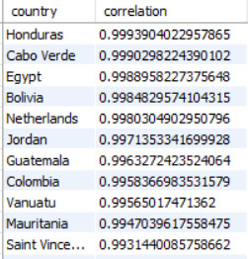
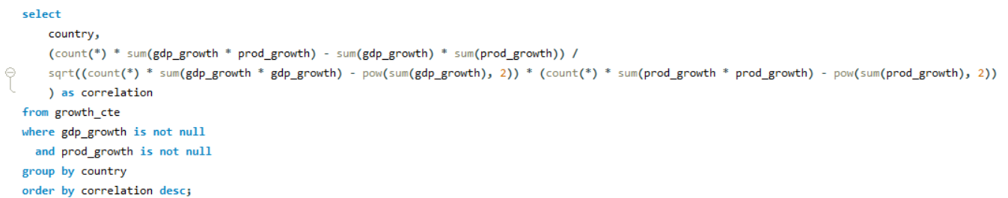
4. Which countries have the highest energy consumption relative to GDP?
Query Output
Key Insights:
Countries like Honduras, Cabo Verde, Egypt, and Bolivia have the highest energy consumption relative to GDP
High values indicate energy-intensive economies with lower efficiency
Some developed countries (e.g., Netherlands, Spain) also show high ratios due to industrial activity
Overall, higher ratio means more energy is used to generate economic output

Slide 23
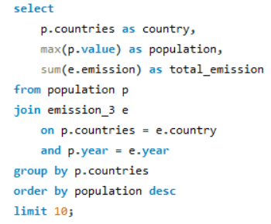
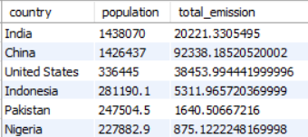
Global Comparisons 1. What are the top 10 countries by population and how do their emissions compare? Query
Output
Key Insights:
China and the United States have the highest emissions among top populated countries
India has a large population but lower emissions compared to them
Countries like Pakistan, Nigeria, and Bangladesh have high population but low emissions

Slide 24
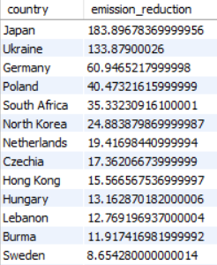
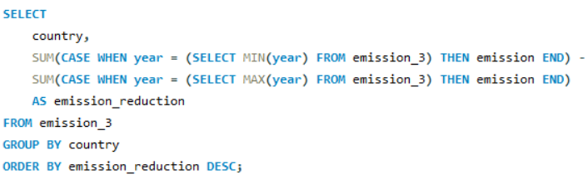
2. Which countries have reduced their total emissions the most over time? Query
Output
Key Insights:
China, India, and the United States show the highest emission reductions.
Large economies dominate the reduction trend.
Small countries show very minimal changes.

Slide 25
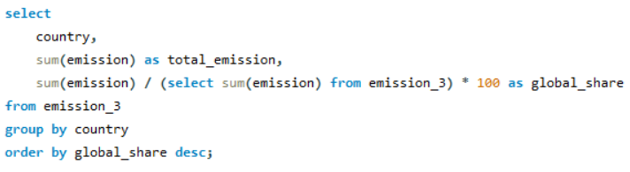
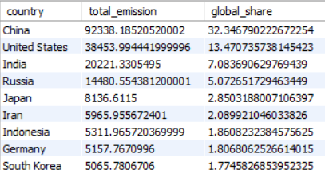
3. What is the global share (%) of emissions by country?
Query
Output
Key Insights:
China (~32%) and United States (~13%) contribute the largest share of global emissions.
India (~7%) and Russia (~5%) are also major contributors.
Most other countries contribute less than 2% each, showing emissions are concentrated in a few nations.

Slide 26
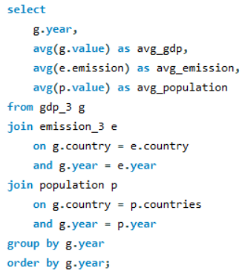
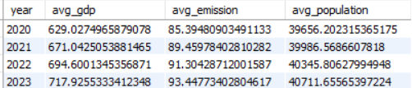
4. What is the global average GDP, emission, and population by year?
Query
Output
Key Insights:
Global average GDP, emissions, and population show a steady increase from 2020 to 2023.
This indicates overall economic growth along with rising environmental impact.

Slide 27
Key Insights and Recommendations
Emissions
Global emissions are increasing year by year, mainly due to fossil fuel usage.
Coal and petroleum are the biggest contributors to emissions.
Countries like China, USA, India dominate global emissions.
Need to shift towards renewable energy sources to reduce impact.

Slide 28
Key Insights and Recommendations
Energy
Many countries show energy deficit (consumption > production).
High dependency on energy imports in deficit countries.
Resource-rich countries have high production per capita.
Improving energy efficiency and local production is important.

Slide 29
Key Insights and Recommendations
Economy (GDP)
GDP is growing steadily across most countries.
Higher GDP countries also show higher energy usage.
Economic growth is strongly linked with energy demand.
Need to balance growth with sustainability policies.

Slide 30
Key Insights and Recommendations
Population
Population growth leads to increase in energy demand and emissions.
Developing countries show rapid population-driven impact.
Some developed countries control emissions despite population changes.
Focus required on efficient energy usage per person.

Slide 31
Key Insights and Recommendations
Overall
Energy, economy, and emissions are strongly interconnected.
Few countries (majorly China,US,India,Russia) contribute major share of global emissions.
Per capita analysis shows huge inequality across countries.
Future focus should be on sustainable energy + efficiency + policy changes.

Slide 32
Conclusion
Global energy consumption and emissions are steadily increasing alongside economic growth and population expansion. A few countries contribute a major share of global emissions, while many others have comparatively lower impact. The rising demand for energy highlights the strong link between development and resource usage. Therefore, adopting sustainable energy sources and improving efficiency is essential for balancing growth with environmental responsibility.

Slide 33
Challenges Faced
Comparing multiple query results to derive final insights was sometimes complex but also helped in deeper analysis.
Analyzing trends across different countries and years was challenging due to fluctuations and inconsistent patterns.
Writing queries with window functions like LAG() for YoY analysis was challenging to understand and implement correctly.
Calculating ratios such as emission-to-GDP and per capita values needed proper aggregation and accurate joins.

Slide 34


THANK
YOU

